Slide 1
Transforming IFRS 9 Compliance: A streamlined ECL Engine Solution
Compliant, Auditable, Deployable
• Lifetime PD
• Cashflow LGD
• Stage 3 ECL
• Scenario-Weighted
Kore Sampath Kumar

Slide 2
Executive Summary
IFRS 9 compliance is mandatory for expected credit loss (ECL) reporting Manual/semi-automated processes are slow, error-prone, and difficult to audit
Our IFRS 9 Engine provides:
✓ Stage-aware PD & ECL calculation
✓ Cashflow-based LGD modeling
✓ Stage 3 discounted recoveries
✓ Scenario-weighted outputs
✓ SQL & Airflow integration
Key Benefits:
• Reduce month-end close from days to hours
• Eliminate audit findings and regulator challenges
• Enable dynamic stress testing capabilities
• Transparent, auditable methodology

Slide 3
Problem Statement
Current Challenges in IFRS 9 Compliance:
Operational Inefficiency:
  Excel-based calculations – Manual errors, version control issues
  Slow reporting cycles – 5-10 day month-end close process
  Limited scenario analysis – Inadequate stress testing for regulators
Compliance Risk:
  Opaque methodologies – Difficult audit defense, long review cycles
  Model risk – Unvalidated assumptions, inconsistent calculations
Financial Impact:
  High consultancy costs – $500K+ annually for external support
  Regulatory penalties – Potential fines for non-compliance
  Missed insights – Limited ability to optimize provisioning
Result: Regulatory risk, operational inefficiency, and financial waste

Slide 4
Our Solution IFRS 9 Engine – Complete Compliance Platform
Core Capabilities:
Stage-Aware ECL Calculation
  Automated SICR detection
  Lifetime PD for Stage 2+3
  Cashflow-based LGD modeling
  Discounted Stage 3 recoveries
2. Scenario Management
  Base, upside, downside scenarios
  Regulatory-prescribed weighting
  Custom scenario creation
  Sensitivity analysis
3. Automation & Integration
  SQL native connectivity
  Airflow orchestration
  Docker containerization
  Audit trail generation
4. Deployment Options:
  On-premise or cloud
  4-week implementation
  Pilot-to-production methodology

Slide 5
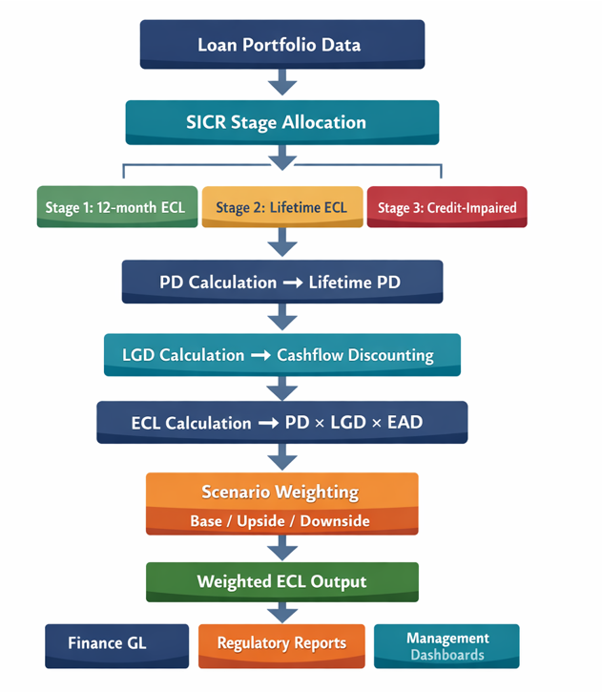
5: How it Works
End-to-End IFRS 9 Calculation Engine

Slide 6
Stage Allocation Logic
SICR-Based Classification Framework
SICR Triggers (Configurable):
DPD Thresholds: 30+ days past due
PD Deterioration: 20%+ increase in 12m PD
Forbearance: Modified terms granted
Watchlist Status: Internal risk rating downgrade
Covenant Breaches: Technical defaults
External Ratings: Downgrade below investment grade
Stage | Criteria | ECL Calculation | Portfolio %
Stage 1 | Performing loans No SICR triggers | 12-month ECL | 85-95%
Stage 2 | Significant credit risk increase (SICR identified) | Lifetime ECL | 5-12%
Stage 3 | Credit-impaired Objective evidence of loss | Lifetime ECL Discounted recoveries | 1-3%

Slide 7
Lifetime PD Modeling
Methodology: From 12-month to Lifetime Projections
Step 1: Convert 12-month PD → Monthly hazard rate
Step 2: Project over remaining loan term
Step 3: Apply scenario multipliers
Step 4: Calculate cumulative lifetime PD
PD Projection Example:
Loan: 5-year term, 36 months remaining, Base PD: 2.5%
 | Weight | ECL | Weighted ECL
Base | 50% | 1.35M USD | 0.68M USD
Upside | 20% | 1.08M USD | 0.22M USD
Downside | 30% | 1.76M USD | 0.53M USD
Total | 100% |  | 1.4M USD

Slide 8
Cashflow-Based LGD
Regulator-Preferred Methodology
Traditional vs. Cashflow Approach
Calculation Formula: Example Calculation:
LGD = 1 - [PV(Recoveries) / EAD]
Where:
• PV(Recoveries) = Σ [Recovery_t / (1 + r)^t]
• EAD = Exposure at Default
• r = Effective Interest Rate (EIR)
Method | Calculation | Regulator View
Static LGD | Historical average loss | Less preferred
Cashflow LGD | Discounted recovery projections | Gold Standard
Loan Type | EAD | Collateral | Recovery PV | LGD
Mortgage | $500,000 | $400,000 | $380,000 | 24.0%
Auto Loan | $50,000 | $30,000 | $28,500 | 43.0%
Unsecured | $25,000 | $0 | $5,000 | 80.0%

Slide 9
Scenario Weighting & ECL
Comprehensive Stress Testing Framework
Regulatory Requirement:
  Multiple forward-looking scenarios
  Probability-weighted outcomes
  Documented rationale for weights
Scenario Framework:
ECL Calculation Example:
Portfolio: $100M corporate loans
Average PD: 3% | Average LGD: 45%
Total Weighted ECL: $1.43M (1.43% of portfolio)
Scenario | Probability | PD Multiplier | LGD Impact
Base Case | 50% | 1.0x | +0%
Upside | 20% | 0.8x | -5%
Downside | 30% | 1.3x | +15%
Scenario | Weight | ECL | Weighted ECL | Cumulative
Base Case | 50% | $1.35M | $0.68M | $0.68M
Upside | 20% | $1.08M | $0.22M | $0.90M
Downside | 30% | $ 1.76M | $0.53M | $1.43M

Slide 10
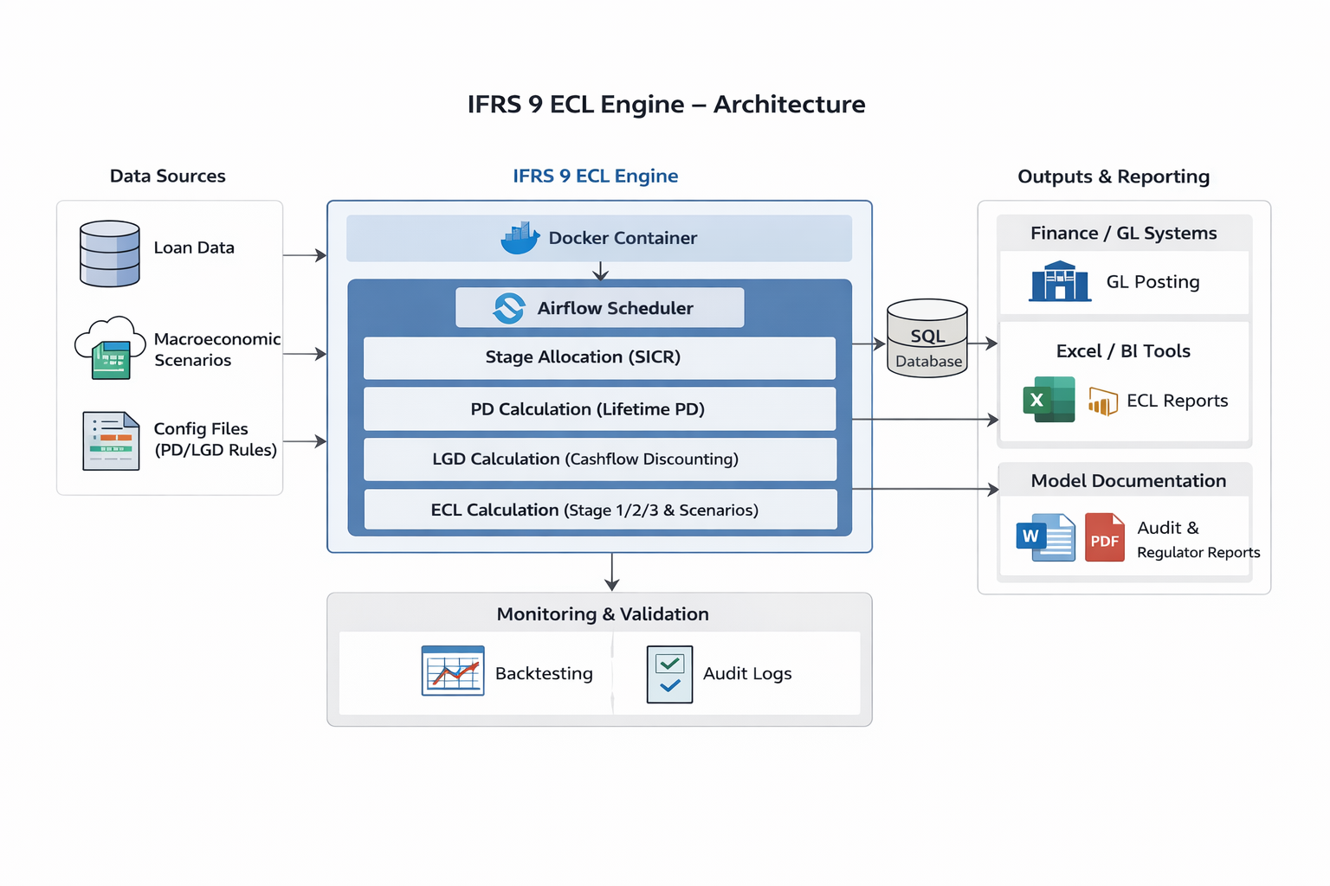
Architecture & Integration
Orchestrator Layer
  Apache Airflow
  Monthly ECL Calculation DAGs
  Automated Scheduling
  Error handling & Alerts
Calculation Engine
  Python + Docker
  PD/LGD/ECL models
  Scenario management
  Audit logging
Data Layer
  SQL Database
  Input: Loan Portfolio
  Output: ECL Results
  Archive: Historical Data
Consumption Layer
  Finance GL Systems
  Regulatory Reports
  Management Dashboards
  External Auditors

Slide 11
Deployment Time
Week 1 Pilot & Configuration | Week 2 Validation & Calibration | Week 3 Integration & Testing | Week 4: Go-Live & Training
Data extraction (sample portfolio) | Output validation vs. current process | Production data integration | Production deployment
Environment setup | PD/LGD calibration | End-to-end testing | User training
Initial configuration | Scenario configuration | User acceptance testing | Documentation handover
First test run | Regulatory alignment | Performance optimization | Support transition

Slide 12
Thank you

